Slide 1








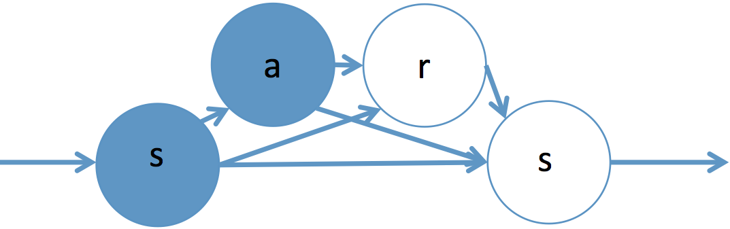
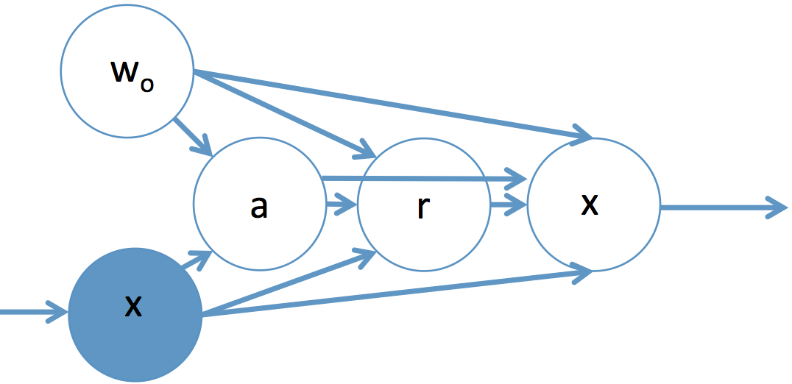

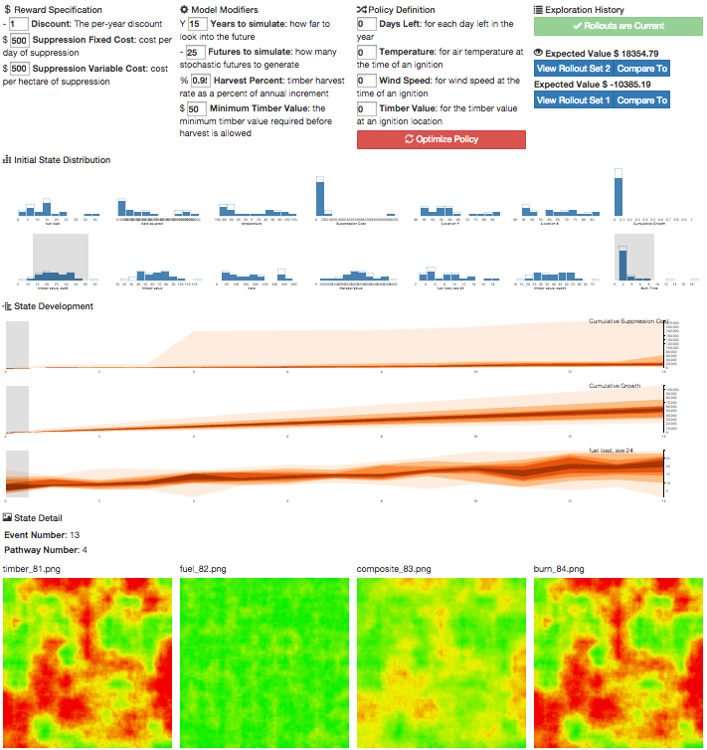

School of Electrical Engineering and Computer Science
Fast Simulation for Computational Sustainability Sequential Decision Making Problems
Sean McGregor, Rachel Houtman, Hailey Buckingham, Claire Montgomery, Ronald Metoyer, and Thomas G. Dietterich
Abstract
Solving sequential decision making problems in computational sustainability often requires simulators of ecology, weather, fire, or other complex phenomena. The extreme computational expense of these simulators stymie optimization and interactive visualization of decision rules (policies). This work presents our results in creating an interactive visualization for a wildfire management problem whose simulator normally takes several hours to run. We successfully generate visualizations for a landscape’s development over 100 year time spans within 3 seconds, when the original simulator took several hours.
Markov Decision Processes
A theoretical formulation for sequential decision making subject to uncertainty
Wildfire management¹
Timber harvest planning
River flow management
Invasive species eradication²
Goal: Visualize and Optimize Decision Rules
Wildfire: given a wildfire on timber producing lands, how do we balance suppression costs, timber revenues, and ecological services when deciding to suppress a fire or let it burn?
Problem: Simulating Nature is Computationally Expensive
Simulating ecological processes over many decades requires models for weather, climate, fire spread, human encroachment, succession, and more. These models can take hours or days to complete a single scenario!
Solution: Synthesize Trajectories from a Database
Generate a dataset of simulations from many different policies
When visualizing or optimizing a policy that has not been sampled, use state similarity to “stitch” states together into complete trajectories
Visualize^{4,5} or optimize based on the generated trajectories
State Variables in Computational Sustainability Domains
We model variables in the database differently based on whether they are persistent or exogenous. Persistent variables are highly correlated from one time step to another, but exogenous variables are independent and identically distributed within every time step.
Suppress
Suppress
Persistent
Plant cover
Fuel levels
Species presence/absence
Elevation, latitude, and longitude
Exogenous
Weather events
Wildfire Ignitions
Invasive species introduction
Timber prices
Let Burn
Suppress
How do We Model Persistent and Exogenous Variables?
We stitch to a state in the database if it is similar to the state we are in. Similarity does not need to include exogenous variables! Traditionally, similarity is measured against the complete state and action as highlighted below. In our version of trajectory synthesis, we separate the action and exogenous variables and stitch based solely on the persistent state.
The probabilistic graphical models shown above factorizes the state such that we can stitch states based solely on the configuration of a persistent state. We don’t need to consider similarity of exogenous variables like weather!
More formally, a Markov Decision Process is
Transition is in Database
S | All States of the World
P₀ | Starting State Distribution
A | Available Actions
R(s, a) | Rewards
γ∈ (0, 1) | Discount
P | State Transition Probability
π(s) → a | Policy
Let Burn Result
Standard Markov Decision Process (MDP) Transition
Suppress
Transition is not in Database so we “Stitch” to the most related landscape
A wildfire suppression Markov Decision Process is
Suppress Result
S | All tree and weather configurations
P₀ | A snapshot of the current forest, with a random fire
A | Suppress or let-burn
R(s, a) | Timber harvest, Suppression Expense
γ∈ (0, 1) | 0.96 (Forest Service Standard)
P | Several Simulators
π(s) → a | Suppress all fires
Our Trajectory Synthesis Transition
W_{O}: Weather and ignition location
MDPVis.github.io
X: Fuels and timber on landscape
Conclusion
We can visualize and optimize policies for computationally expensive sustainability domains with a database of state transitions whose computational cost is independent of the computational cost of the modeled phenomena.
References
1: Houtman, R. M., Montgomery, C. A., Gagnon, A. R., Calkin, D. E., Dietterich, T. G., McGregor, S., & Crowley, M. (2013). Allowing a Wildfire to Burn: Estimating the Effect on Future Fire Suppression Costs. International Journal of Wildland Fire, 22(7), 871–882.
2: Dietterich, T., Taleghan, M., & Crowley, M. (2013). PAC Optimal Planning for Invasive Species Management: Improved Exploration for Reinforcement Learning from Simulator-Defined MDPs. Twenty-Seventh AAAI Conference on Artificial Intelligence.
3: Fonteneau, R., Murphy, S. a, Wehenkel, L., & Ernst, D. (2013). Batch Mode Reinforcement Learning based on the Synthesis of Artificial Trajectories. Annals of Operations Research, 208(1), 383–416.
4: McGregor, S., Buckingham, H., Dietterich, T. G., Houtman, R., Montgomery, C., & Metoyer, R. (2015). Facilitating Testing and Debugging of Markov Decision Processes with Interactive Visualization. In IEEE Symposium on Visual Languages and Human-Centric Computing. Atlanta.
5: McGregor, S., Buckingham, H., Houtman, R., Montgomery, C., Metoyer, R., & Dietterich, T. G. (2015). MDPvis: An Interactive Visualization for Testing Markov Decision Processes. In AAAI Fall Symposium on Sequential Decision Making for Intelligent Agents.

